Slide 1
On Being a Student, and a Citizen, and a Human, in the Anthropocene
*
Nathan John Hagens,
Director: Bottleneck Foundation, IIER, ISEOF
UBC Vancouver
10/14/2014

Slide 2
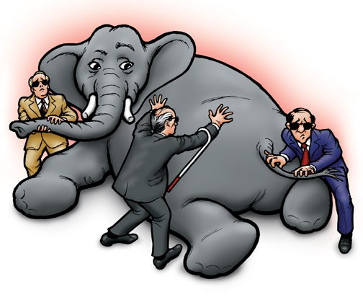
Energy
Ecology
Money/
finance
Human Behavior
Technology
FIRST PRINCIPLES

Slide 3
OVERVIEW
First Principles
Energy
Money/economics
Human Behavior
Environment
Synthesis: the present and the future
What to do

Slide 4
OVERVIEW
First Principles
***ENERGY***
Money/economics
Human Behavior
Environment
Synthesis: the present and the future
What to do

Slide 5
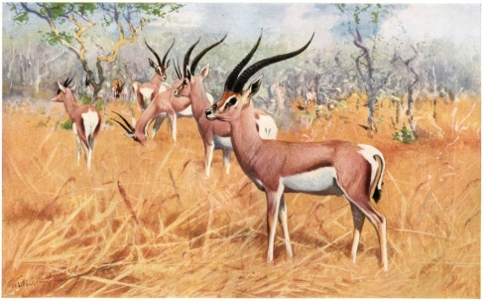

Slide 7
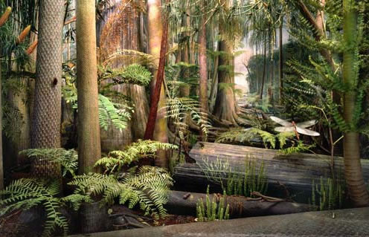
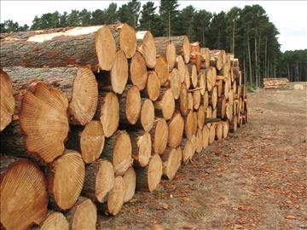
Our economy uses…..
ANCIENT SUNLIGHT
(Coal, Oil, Natural Gas)
OLD SUNLIGHT
Timber, trees, lumber
CURRENT SUNLIGHT
Crops, animals, wind, solar, etc.

Slide 8
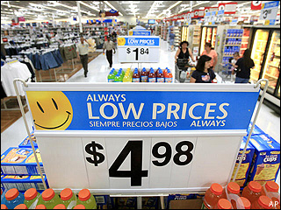
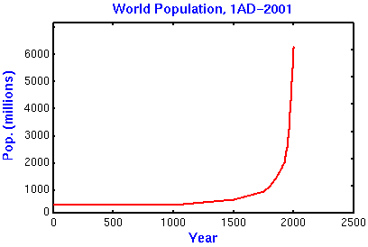
Wages
Profits
Goods
# People

Slide 10
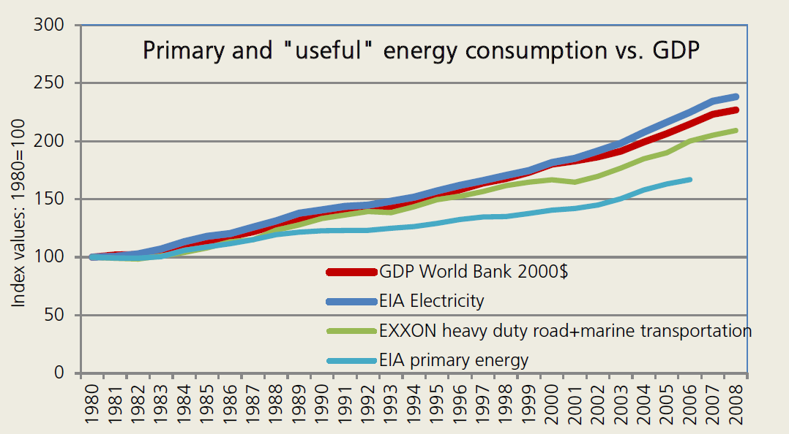
Source: “Green Growth an Oxymoron?” IIER 2011

Slide 11
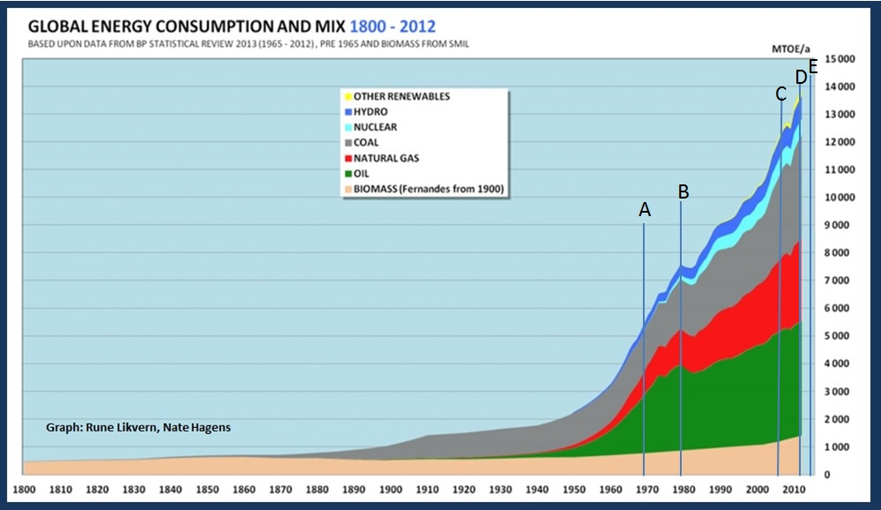

Slide 12
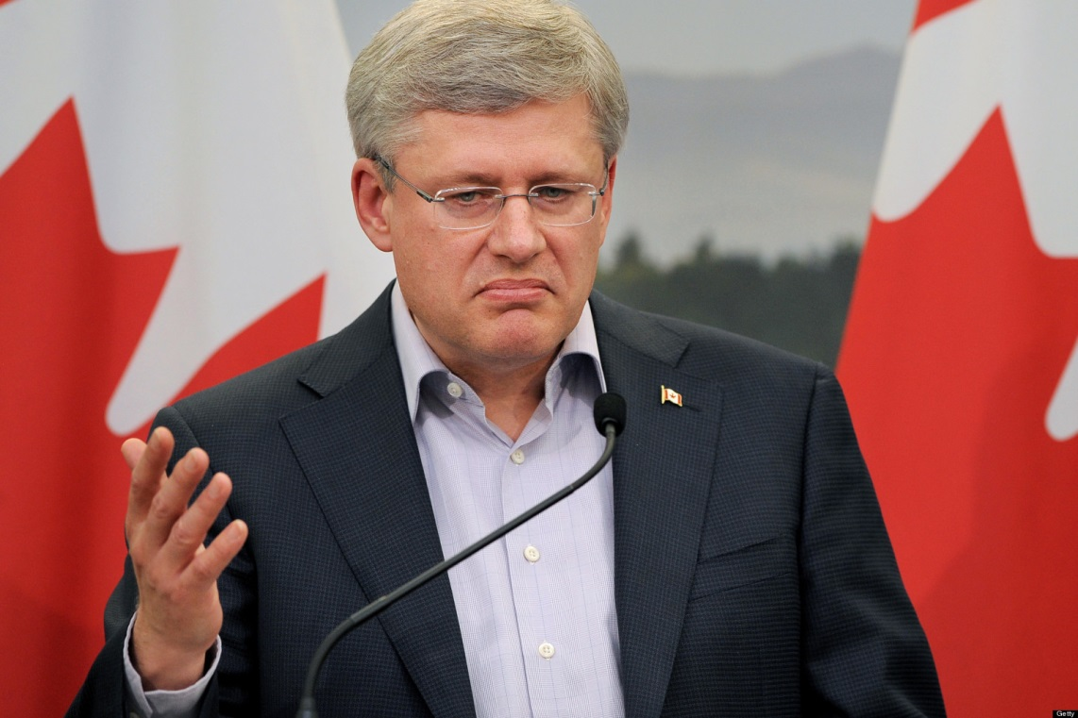
But oil and all energy is just an input. It is substitutable!

Slide 13
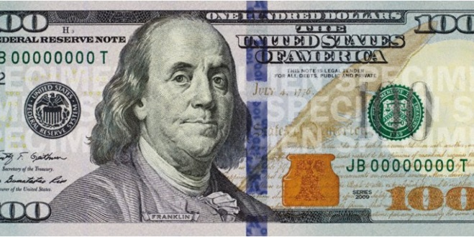
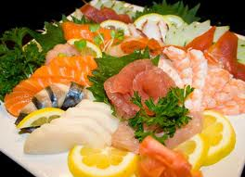

Slide 14
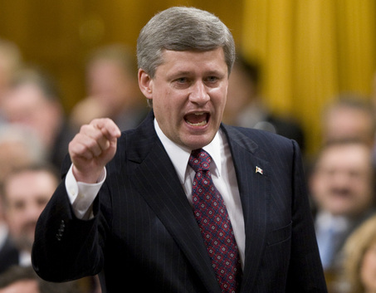
Ahem. The Cobb Douglas function fully explains growth and is solely based on capital (K) and population (P) and productivity factor (b).

Slide 15
150 Horse
1/10 Horse
1 Horse
45 Horse

Slide 17
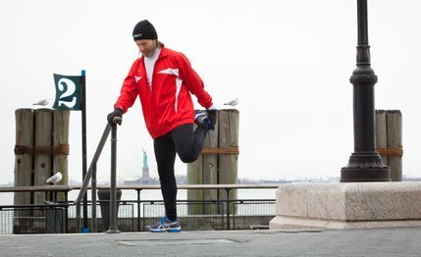
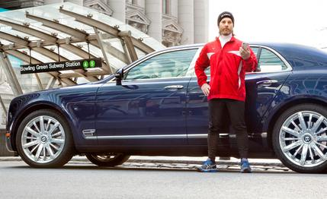
The key story of industrialization was adding large amounts of cheap energy to replace activities humans previously did

Slide 18
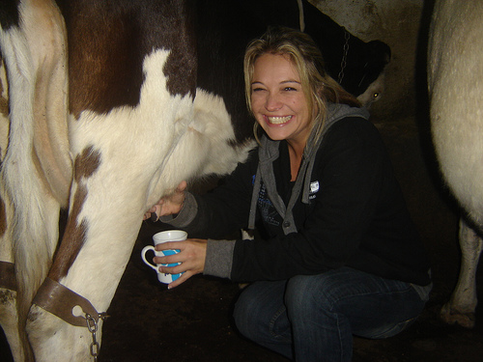
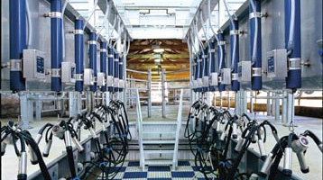
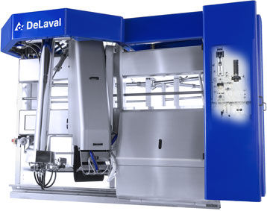
min 15 min 3 min
0 300kWh 700kWh
$3/hr $5/hr $15/hr
Model /data IIER

Slide 19
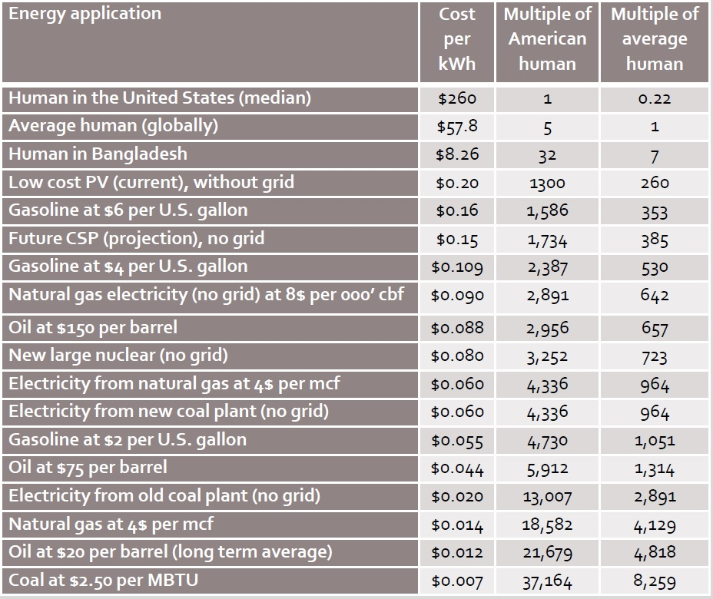
Humans / energy Cost Ratios
Quantity and price of applied energy are key drivers of economic output in any society
Source: IEA, EIA, IIER, others

Slide 20
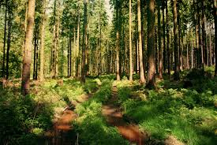
$50
$40
$30
$20
$10
$5

Slide 21
$50
$40
$30
$20
$10
$5

Slide 22
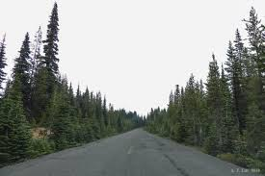
$50
$40
$30
$20
$10
$5
0 50

Slide 23
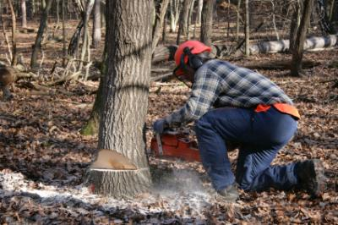
$50
$40
$30
$20
$10
$5
0 50 100

Slide 24
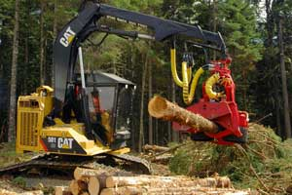
$50
$40
$30
$20
$10
$5
0 50 100 200

Slide 25
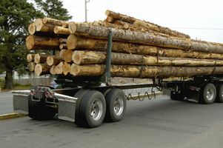
$50
$40
$30
$20
$10
$5
0 50 100 200 400

Slide 26
$50
$40
$30
Gasoline goes from $2 to $4
$20
$10
$5
0 50 100 200 400

Slide 27
$50
$40
$30
Gasoline goes from $2 to $6
$20
$10
$5
0 50 100 200 400

Slide 28
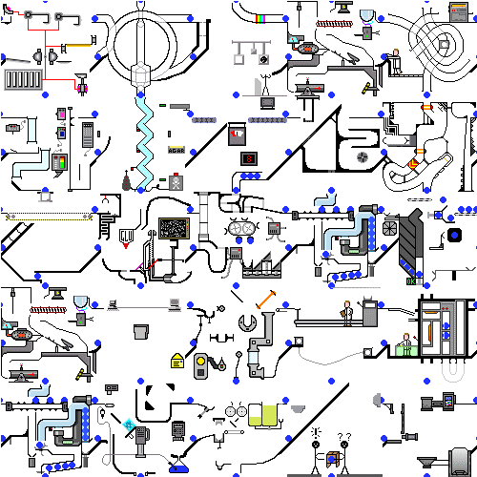

Slide 30
Humans / energy Cost Ratios
Quantity and price of applied energy are key drivers of economic output in any society
Source: IEA, EIA, IIER, others

Slide 31
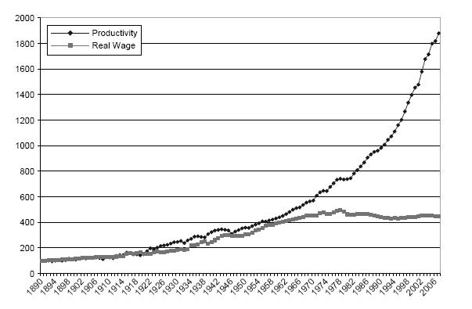
Fossil ‘magic’ increasingly went more towards productivity, than wages
Richard Wolff, U-Mass Amherst

Slide 32
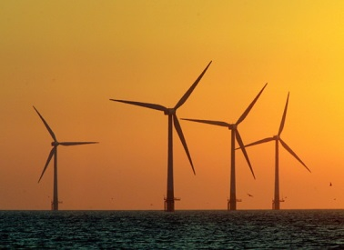
How does technology relate to energy?
New
Energy Creation
Human Labor Replacement
New resource Conversions
Resource/Energy
Efficiency

Slide 33
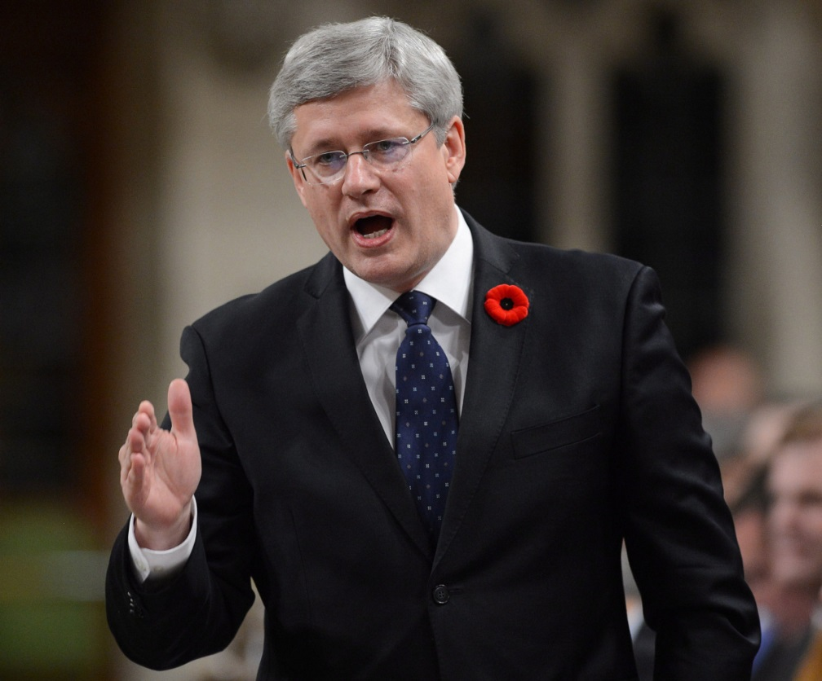
Wait son. There are plenty of energy and resources and they get cheaper over time. More money and more technology will access all the energy we need.

Slide 34
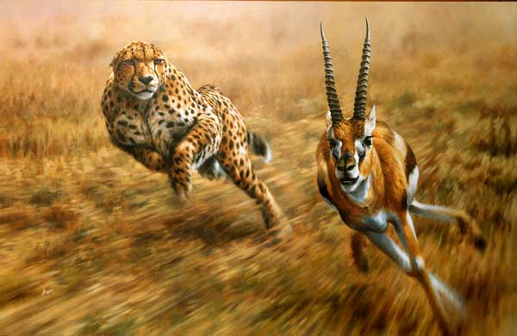

Slide 35
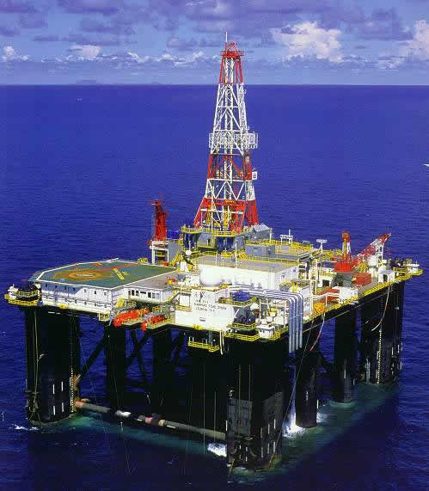

Slide 36
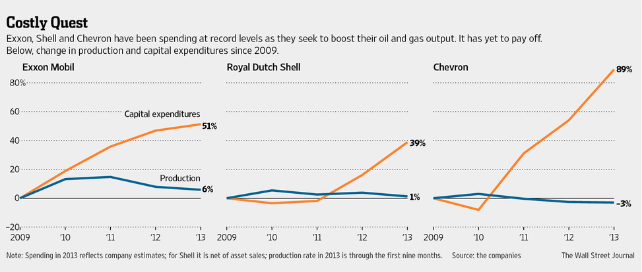

Slide 37
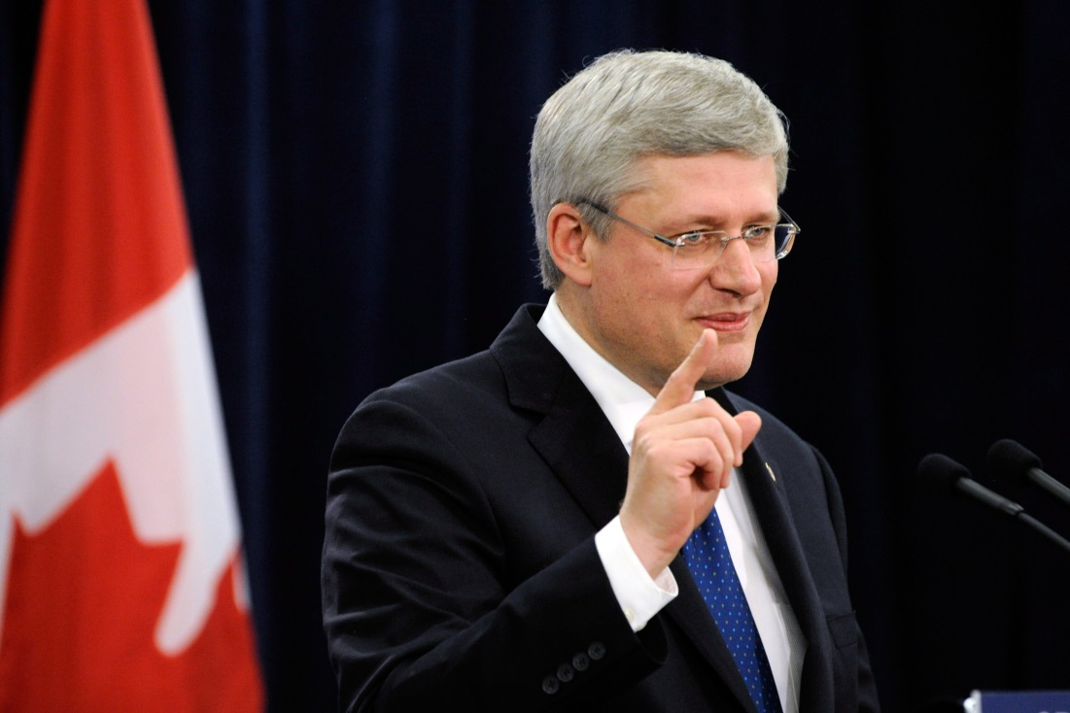
Yes but the US is going to be the new Saudi Arabia. Bakken Shale, etc – Canada has literally have hundreds of years of fossil fuels in the ground.

Slide 38
$120
$9
Data from: 4/13 Goldman Sachs – “Higher Long Term Prices required by a troubled industry”

Slide 39
OVERVIEW
First Principles
Energy
****Money/economics****
Human Behavior
Environment
Synthesis: the present and the future
What to do

Slide 42
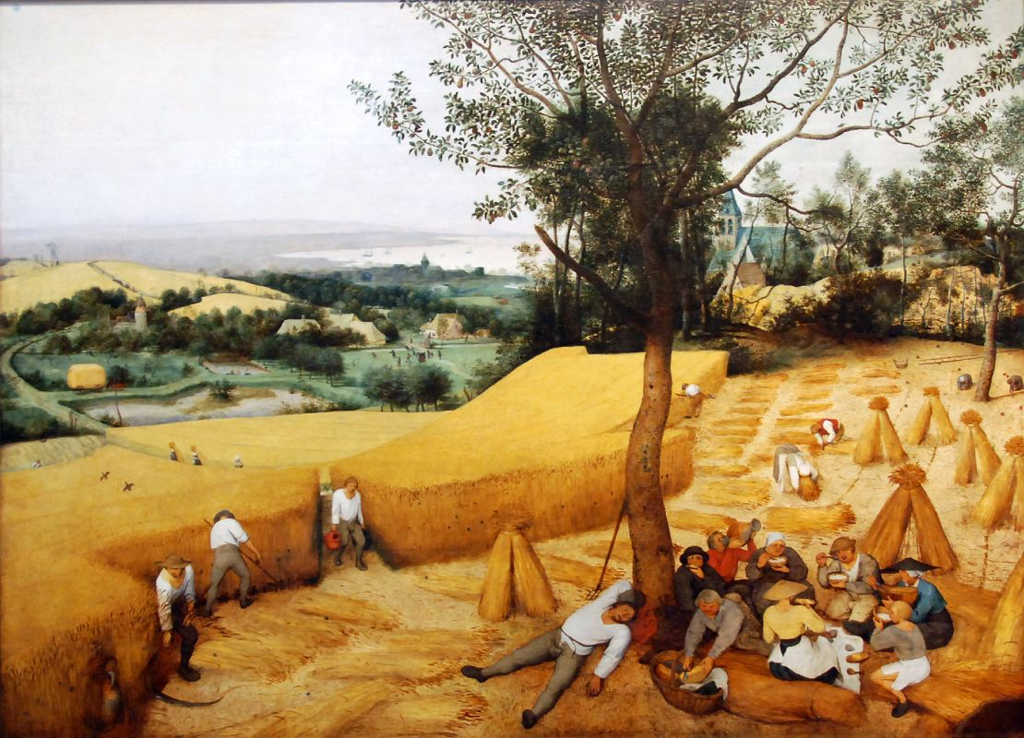

Slide 43
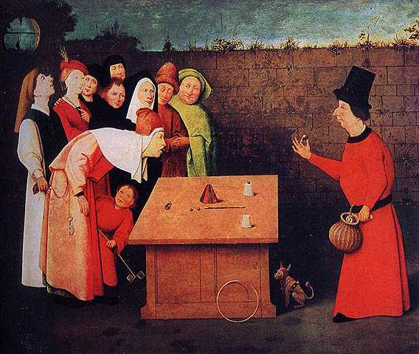

Slide 44
Excuse me sir. Economics textbooks clearly state that banks only act as intermediaries…

Slide 45
Declining debt productivity

Slide 46
Energy (real capital)
Money (marker capital)

Slide 47
Energy (real capital)
~1971
Money (marker capital)

Slide 49
Briefly, behavior…

Slide 50
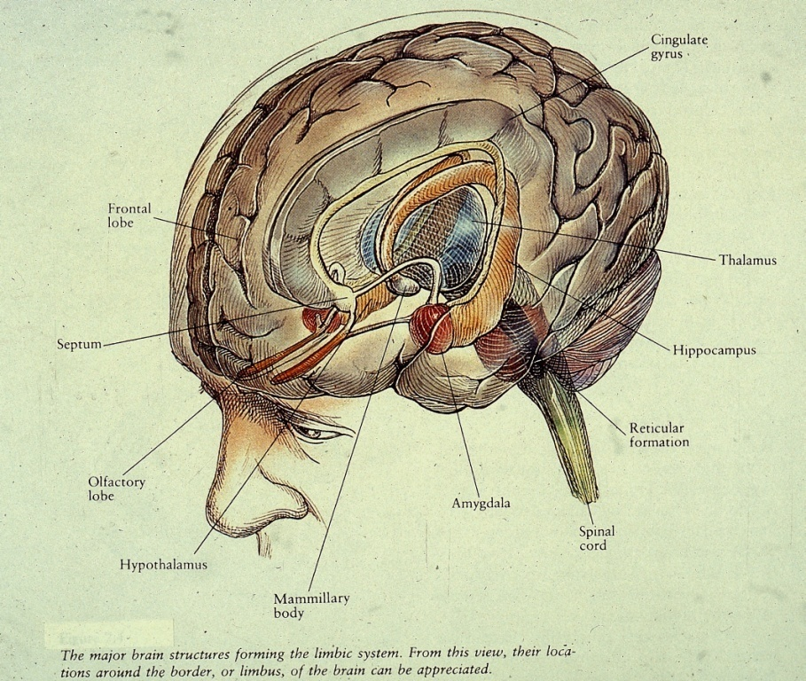
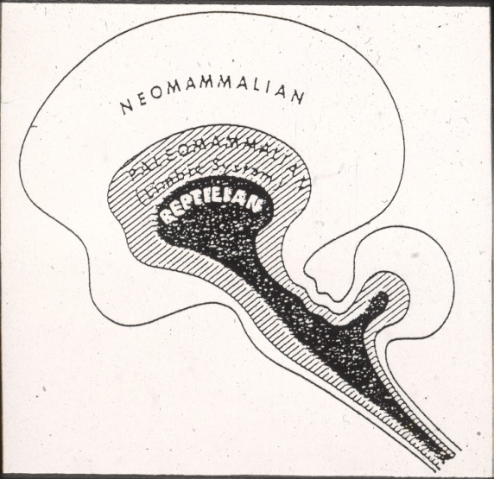
BEHAVIOR IS BEST UNDERSTOOD THROUGH THE LENS OF EVOLUTION
HOMO SAPIENS
EVOLVED AMIDST
SCARCITY
FROM MACLEAN: THE TRIUNE BRAIN
Graphic Credit: Dr. Peter Whybrow – UCLA – Author of “American Mania”
Notes:
1. The brain is a physical system. It functions as a computer. Its circuits are designed to generate behavior that is appropriate to the environmental circumstances.2. Our neural circuits were designed by natural selection to solve problems that our ancestors faced during our evolutionary history.
3. Consciousness is just the tip of the iceberg; most of what goes on in your mind is hidden from you. As a result your conscious mind can mislead you into thinking that our circuitry is simpler than it really is. Most problems that you experience as easy to solve are actually very difficult to solve-they require very complicated neural circuitry.
4. Different neural circuits are designed for solving different adaptive problems.
5. (and the famous one) Our modern skulls house a stone age mind.

Slide 51
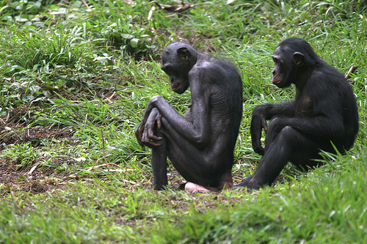

Slide 52
Wooohooo!!! I can’t wait to see what my grandkids look like!!!!!!

Slide 57
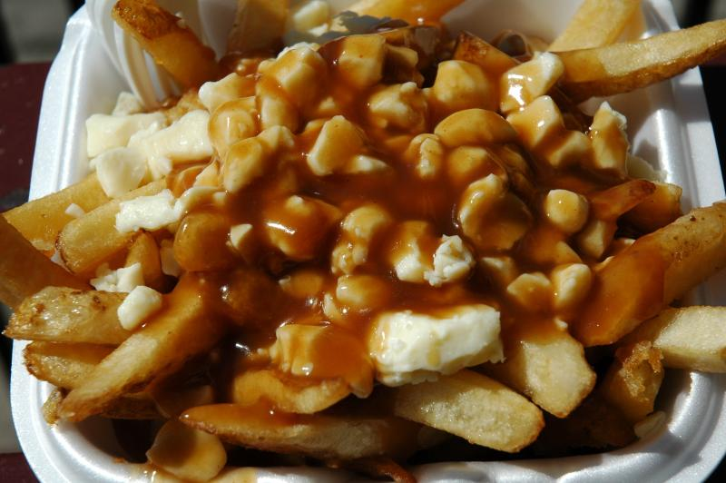

Slide 60
Supernormal Stimuli
Drawing adapted from stuartmcmillen.com

Slide 61
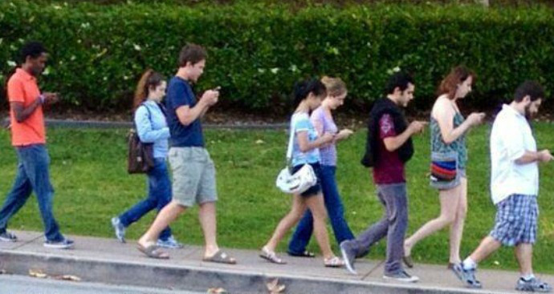
Borrowing from the future?

Slide 62
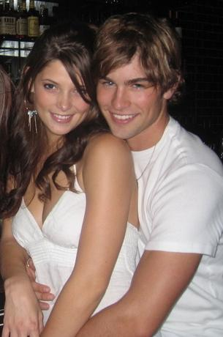
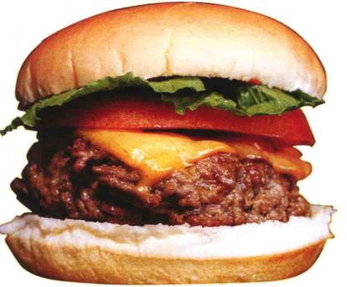
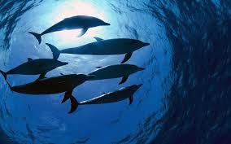
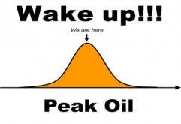

Slide 63
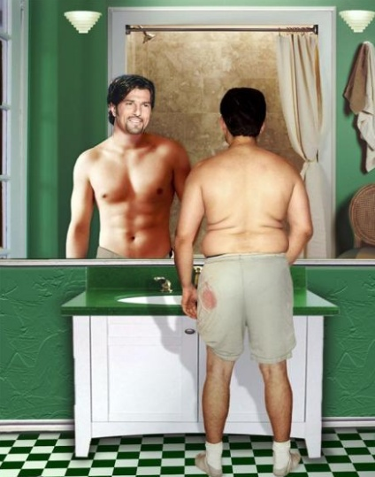

Slide 64
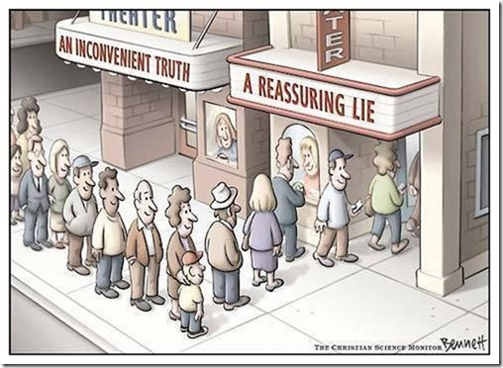
Notes:
Human behavior plays a central role both in why we don’t address these societal problems and what we might be able to do about them. The situation we face is complex and daunting and for most, its better (healthier) if we ignore it – assuming it will go away or someone else will solve it. Of course, if we all ignore it, the eventual reckoning will be worse.

Slide 65
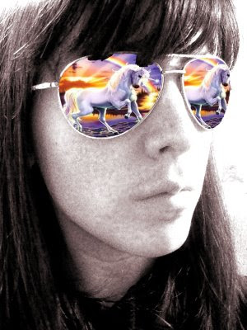

Slide 66
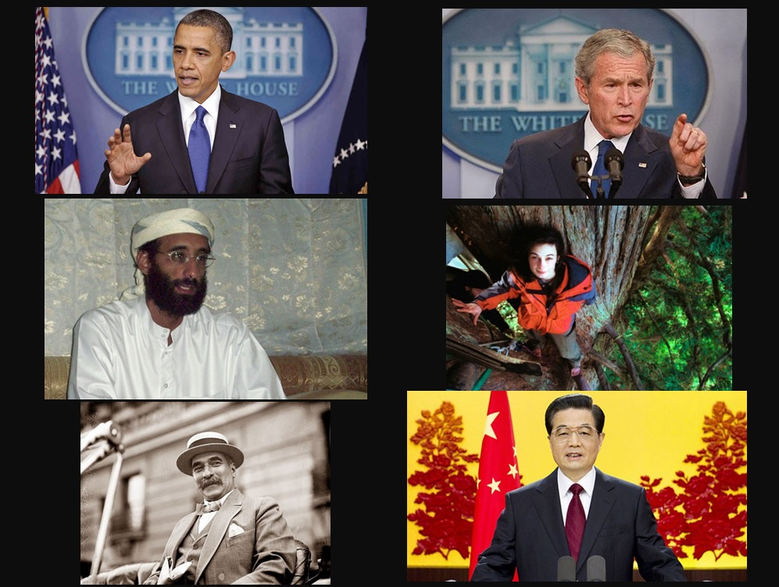

Slide 68
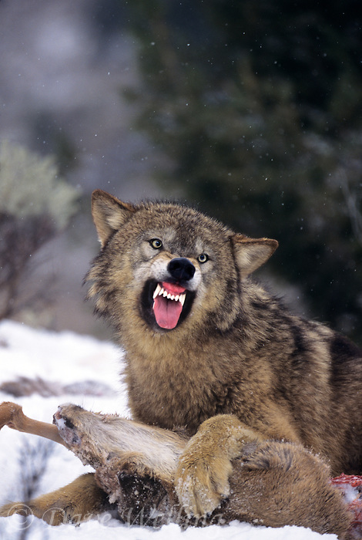
Notes:
From an evolutionary/societal standpoint, the system is working fine. Those of us saying we need to switch to a lower carbon future, or tighten our belts, or conserve, or change our aspirations are viewed as fringe/annoying/marginal. Society is still feasting on rich feeding grounds (fossil carbon) so any attempts to approach high status individuals (politicians, CEOs, etc) about these problems are met with resistance/derision.

Slide 69
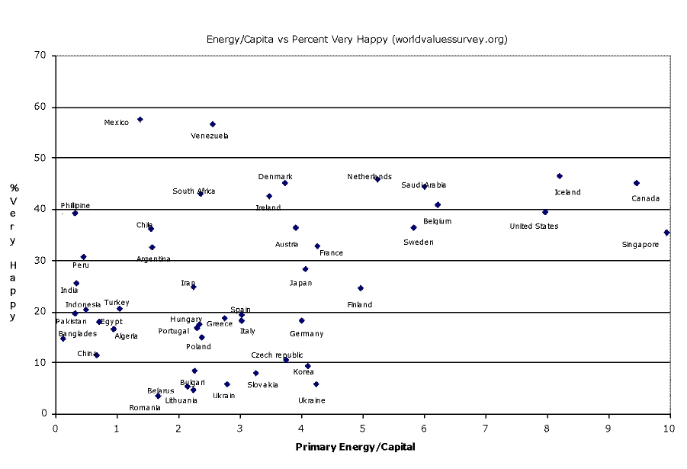
Energy/Capita vs. % Very Happy – (worldvaluesurvey.org)

Slide 70
OVERVIEW
First Principles
Energy
Money/economics
Human Behavior
****Environment****
Synthesis: the present and the future
What to do

Slide 71
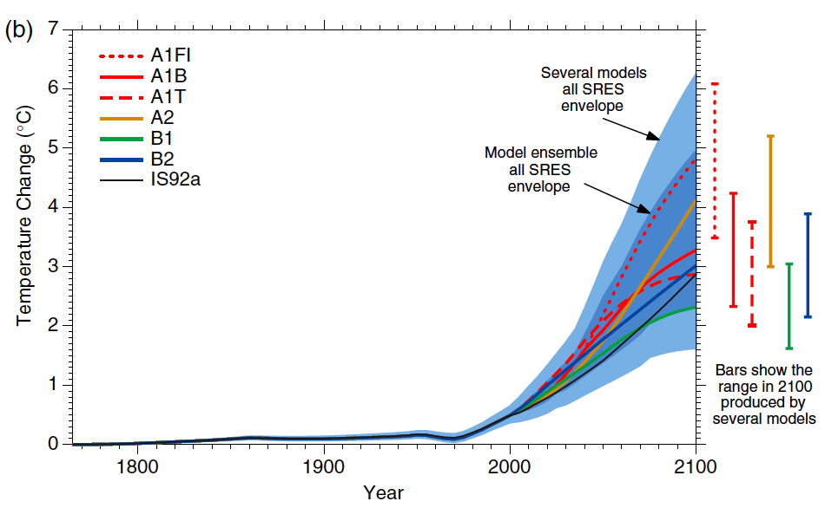

Slide 72
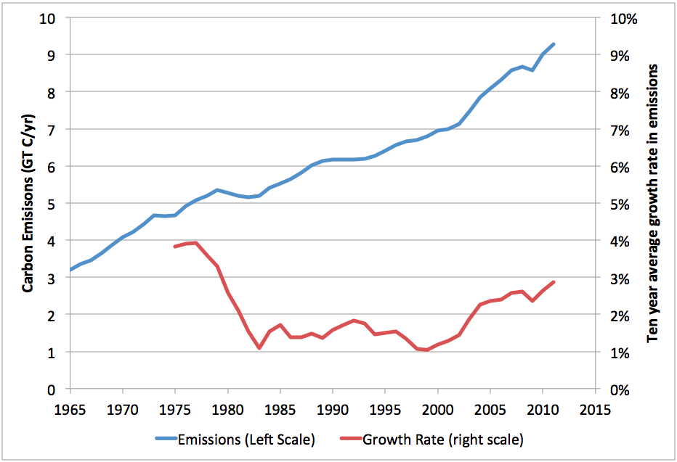
“A central finding of WGIII is that growth of income has been the largest single driver of emissions.” Victor, Science July 2014.
Source: Stuart Staniford: EarlyWarn

Slide 76
Data from Smil, Chefurka, Graphic Paul Chefurka

Slide 77
Jeez.. Really?
Even Canada??

Slide 78
What’s Beaver For?

Slide 80
OVERVIEW
First Principles
Energy
Money/economics
Human Behavior
Environment
**Synthesis: the present and the future**
What to do

Slide 81
OIL
+
We turn energy and resources
…and dollars into feelings
+ waste
Into dollars
The Human Ecosystem
Past, present and FUTURE

Slide 85
Our Economic “Pie”
More energy, same/less benefits?

Slide 86
Our Economic “Pie”
More money, less benefits (for most)?

Slide 88
1970
2007
2014
Future

Slide 90
For most people growth is already over…
Income development 2002-2012, U.S. census data (www.census.gov), graphic IIER

Slide 91
min 15 min 3 min
0 300kWh 700kWh
$3/hr $5/hr $15/hr
Model /data IIER

Slide 92
Renewables
Fossil Hydrocarbons

Slide 94
Conclusions

Slide 95
Conclusions
Money is a marker for energy and natural resources.
2) For most people growth is already over.
3) There is no shortage of energy but a longage of expectations.
Biology determines what we need, culture determines how we get it.
We’re heading for a lower consumption, more local and regional future.
6) We are still incredibly rich by historic standards
7) Our predicament is not technical, but socio-political

Slide 96
Some Suggestions for the professors
1. More skills and knowledge applicable and relevant to a future with ‘less’ stuff and ‘more’ environmental constraints
2. We need detailed expertise and continued specialization, but perhaps the academy can stop rewarding hyperspecialization associated with reductionism.
3.Develop a holistic awareness of our human relationship to the natural world and use that as a basic platform from which you work
4. Don’t be afraid to have and defend an unpopular viewpoint. A highly-educated, disciplined mind is a terrible thing to waste.
5. Perhaps new rules for tenure track or successful businesspeople to have a prosocial ‘capstone’ project when they turn e.g. 60

Slide 97
Some Suggestions for the students
Learn as much as you can and acquire knowledge. Especially in natural sciences
Start thinking, at a young age in terms of ‘real capital’
3. Observe, listen, experience and then think for yourselves.
We need technology (not new gadgets) to help us transition to a more sustainable arrangement with the planet and eachother. But this might equally come from the ‘demand’ side as from the ‘supply’. You have to be the key architects of how this unfolds
Someone (in the very near future) has to ‘wear the adult pants’ and look at our predicament using multiple lenses instead of just the one ‘profit’ lens.

Slide 98
(some) Key Questions for young (pro-social) scientists
How do we create an accurate biophysical balance sheet of our natural resource and sink capacities?
How do we do the same thing for our human brain and evolved behavioral wiring?
How do we balance human needs between current and future generations? Between us and other species? Between those alive today?
How do we implement pro-environmental policies when growth/wages/profits are declining?
What do we aspire to, as a species? What do we want the future to look like? What are we willing to give up to get there? Anything?

Slide 101
There could be a great future in this place. Different but great.
Keep learning and thinking and doing….

Slide 102
“We cannot solve our problems with the same thinking we used when we created them.” Albert Einstein

