Slide 1
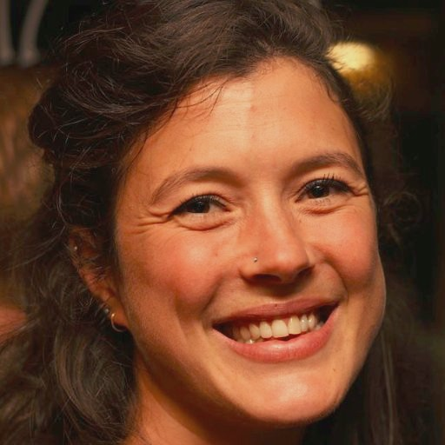
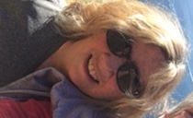
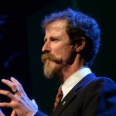
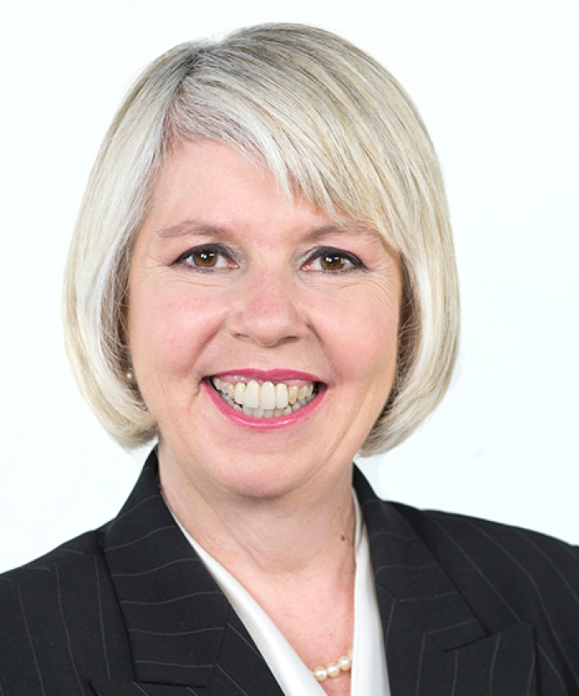
Environmental Policy and
Government Relations
Abstract: Environmental policies are crafted by governments, but influenced by stakeholders and lobbyists. In this seminar we will talk to a panel of people outside of academia, in both governmental and government relations roles, to learn about what it's like to build environmental policies from inside and outside the government.
Alaya Boisvert
joined the David Suzuki Foundation in 2013 to campaign for the right to a healthy environment. As the manager of government relations for the Blue Dot project, she worked towards federal recognition of the right to clean air and water, safe food and a stable climate. Alaya now works as the public engagement
manager with the aim of empowering people.
Ann Rowan
Is a manager for Collaboration Initiatives at Metro Vancouver where she is involved in the Ecological Health Plan, the Regional Food System Strategy and other initiatives related to waste prevention, regional prosperity and regional climate action. Ann came to Metro Vancouer from the David Suzuki Foundation.
David Boyd
is the newest faculty member at IRES. He is an environmental lawyer and an expert on human rights and the environment. He has co-chaired Vancouver's Greenest City initiative, worked in the Privy Council Office, and consulted with the Federal government on a variety law reform efforts.
Adriane Carr
is a Vancouver City Councilor with the Green Party. She co-founded B.C.’s green party in 1983, and served as its leader from 2000-2006. She served as Elizabeth May’s deputy in the federal Green Party from 2006-2014. She has an academic background in urban geography and taught for 12 years at Langara College.
♦Thur October 26, 2017 ♦ 12:30-1:30pm ♦ AERL 120
IRES Seminar Series – Prof. Dev. Seminar

